Slide 1

Exploring
#5 Function

Slide 2
Function
What ?
One block code that can called at many place and reuseable .
A JavaScript function is a block of code designed to perform a particular task.
A JavaScript function is executed when "something" invokes it (calls it).
Why ?
We need simple way for maintaining code that will appear at many different place.
We can reuse code: Define the code once, and use it many times.
We can use the same code many times with different arguments, to produce different results.

Slide 3
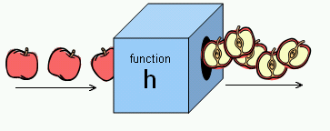
Function
Functions are blocks of code that can be named and reused.

Slide 4
JavaScript Function Syntax
A JavaScript function is defined with the function keyword, followed by a name, followed by parentheses ().
Function names can contain letters, digits, underscores, and dollar signs (same rules as variables).
The parentheses may include parameter names separated by commas:
(parameter1, parameter2, ...)
The code to be executed, by the function, is placed inside curly brackets: {}
function name(parameter1, parameter2, parameter3) {
// code to be executed
}
Function parameters are listed inside the parentheses () in the function definition.
Function arguments are the values received by the function when it is invoked.
Inside the function, the arguments (the parameters) behave as local variables.

Slide 5
Function Invocation
The code inside the function will execute when "something" invokes (calls) the function:
When an event occurs (when a user clicks a button)
When it is invoked (called) from JavaScript code
Automatically (self invoked)
So Declared functions are not executed immediately. They are "saved for later use", and will be executed later, when they are invoked (called upon).
Next we will start practicing making a function and using it

Slide 6
Function Declarations (1st way to build a Function)
function contoh() {
console.log('Halo Dunia!');
}
contoh();// contoh function invoked and the code inside it will be executed
/*
function namafunc(param) {prog}
*/

Slide 7
Function Expression (2nd way)
var contoh = function () {
console.log('Halo Dunia!');
}
contoh();// contoh function invoked
/*
var namafunc = function (param) {prog}
*/

Slide 8
Function
let x = 10
let y = 50
function contoh() {
console.log(x+y)
}
contoh();

Slide 9
Function with a Parameter
function namaku(nama) {
console.log (nama+' Susilo');
}
namaku('Adi');
namaku('Budi');
namaku('Caca');
namaku('Dedi');

Slide 10
Function with 2 Parameters
function data(x,y) {
console.log (x+' Lahir th '+y);
}
data('Adi','1990');
data('Budi','1991');
data('Caca','1992');
data('Dedi','1993');

Slide 11
Return Function
When JavaScript reaches a return statement, the function will stop executing.
If the function was invoked from a statement, JavaScript will "return" to execute the code after the invoking statement.
Functions often compute a return value. The return value is "returned" back to the "caller"
var x = myFunction(4, 3); // Function is called, return value will end up in x
function myFunction(a, b) {
return a * b; // Function returns the product of a and b
}
The result in x will be: 12

Slide 12
Return Function
function total(x,y) {
z = x + y
return z
} console.log(total(4,5))
console.log(z)
/*
- z adalah local variabel dalam func total, tidak dapat
dipanggil di luar func tsb.
- jika z tidak di-return maka total(4,5) = undefined
*/

Slide 13
Return Function
function total(x,y) {
z = x + y
}
console.log(total(4,5))
/*
- z adalah local variabel dalam func total, tidak dapat
dipanggil di luar func tsb.
- jika z tidak di-return maka total(4,5) = undefined
*/

Slide 14
Return Function
function total(x,y) {
z = x + y
console.log(z)
}
console.log(total(4,5))
/*
- z adalah local variabel dalam func total, tidak dapat
dipanggil di luar func tsb.
- jika z tidak di-return maka total(4,5) = undefined
*/

Slide 15
Recursive Function
function Pangkat(x,y){
if (y == 1) {
return x;
}
else {
return x=x*Pangkat(x,y-1);
}
}
console.log(Pangkat(7,2))

Slide 16
Fn inside Fn
function kali(x) {
if (x < 2) {return 1;}
else {return (x * tiga());}
}
function tiga(){
return 3;
}
console.log(kali(5))

Slide 17
setTimeout
setTimeout(waktu, 3000);
function waktu() {
console.log('Halo');
}
console.log('Yuk');
3000 ms (3 detik) setelah program running, output ‘Halo’ muncul. Output ‘Yuk’ muncul lebih dahulu, tanpa menunggu baris kode di atasnya (‘Halo’) selesai.

Slide 18
clearTimeout
var x = setTimeout(waktu, 3000);
function waktu() {
console.log('Halo');
}
clearTimeout(x)
console.log('Yuk');
Baris setTimeout tidak diproses, lantaran dibatalkan seketika oleh clearTimeout.

Slide 19
setInterval
setInterval(waktu, 1500);
function waktu() {
console.log('Halo');
}
Output ‘Halo’ akan muncul tiap 1500 ms (1.5 detik).
Untuk stop proses di cmd, tekan CTRL + C.

Slide 20
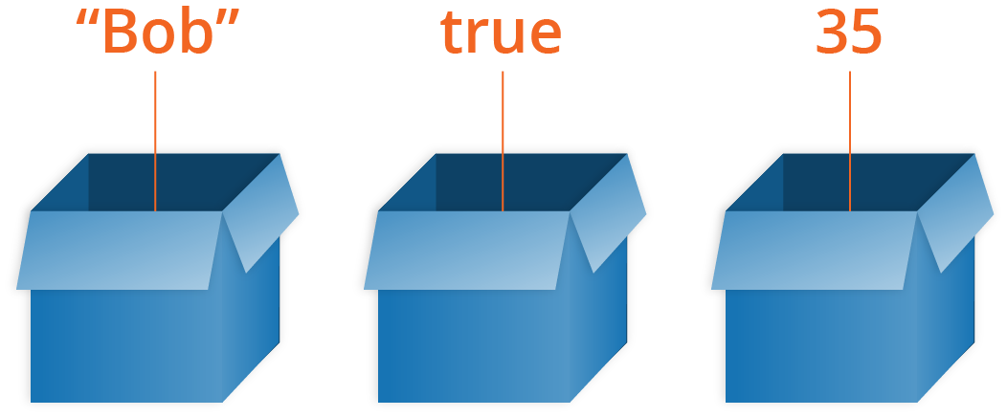

Array
Arrays are container-like values that can hold other values. The values inside an array are called elements.

Slide 21
Array
let mobil1 = 'Alya';
let mobil2 = 'Xenia';
let mobil3 = 'Avanza';
=============================
let mobil = ['Alya','Xenia','Avanza'];
let mobil = [
'Alya',
'Xenia',
'Avanza'
];

Slide 22
Array
let mobil = ['Alya','Xenia','Avanza'];
console.log(mobil)
console.log(mobil.toString())
console.log(mobil.join(' * '))

Slide 23
Array Elements
let mobil = ['Alya','Xenia','Avanza'];
console.log(mobil[0])
console.log(mobil[1])
console.log(mobil[2])
console.log(mobil[3])

Slide 24
Array Elements
let buah, bPjg, i;
buah = ['Jeruk', 'Nanas', 'Apel'];
bPjg = buah.length;
for (i = 0; i < bPjg; i++) {
console.log(buah[i]);
}

Slide 25
Array Properties & Methods
< length, sort, reverse & indexOf >
let mobil = ['Alya','Xenia','Avanza'];
let w = mobil.length;
let x = mobil.sort();
//let y = mobil.reverse();
let z = mobil.indexOf('Avanza');
console.log(w)
console.log(x)
// console.log(y)
console.log(z)

Slide 26
pop & push
let buah = ['Jeruk','Nanas','Apel'];
buah.pop();
console.log(buah)
buah.push('Kiwi');
console.log(buah)

Slide 27
shift & unshift
let buah = ['Jeruk','Nanas','Apel'];
buah.shift();
console.log(buah)
buah.unshift('Lemon');
console.log(buah)

Slide 28
delete & splice
let buah = ['Jeruk','Nanas','Apel'];
buah.splice(2, 0, 'Lemon', 'Kiwi');
console.log(buah)
buah.splice(0, 1);
console.log(buah)
delete buah[0];
console.log(buah)

Slide 29
slice
let buah = ['Banana', 'Orange',
'Lemon', 'Apple', 'Mango'];
let buah2 = buah.slice(1);
console.log(buah2)
let buah4 = buah.slice(1,4);
console.log(buah4)

Slide 30
Adding Array Elements
let buah = ['Jeruk','Nanas','Apel'];
buah.push('Duku');
console.log(buah)
buah[buah.length] = 'Pisang';
console.log(buah)
buah[6] = 'Mangga';
console.log(buah)

Slide 31
Merging (Concatenating)
2 Arrays
let nama1 = ['Andi','Budi'];
let nama2 = ['Caca','Dede','Euis'];
let nama3 = nama1.concat(nama2);
let nama4 = nama2.concat(nama1);
console.log(nama3)
console.log(nama4)

Slide 32
Merging (Concatenating)
3 Arrays
let nama1 = ['Andi','Budi'];
let nama2 = ['Caca','Dede','Euis'];
let nama3 = ['Faza','Gilang'];
let x = nama1.concat(nama2,nama3);
console.log(nama1)
console.log(nama2)
console.log(nama3)
console.log(x)

Slide 33
Solve It!
Buatlah algoritma untuk mengurutkan elemen array berikut:
x = [40, 100, 1, 5, 25, 10]

Slide 34
Numeric Sorting Ascending
Function comparison
let x = [40, 100, 1, 5, 25, 10];
console.log(x)
console.log(x.sort())
x.sort(function(a,b){
return a-b
});
console.log(x)

Slide 35
Numeric Sorting Descending
Function comparison
let x = [40, 100, 1, 5, 25, 10];
console.log(x)
console.log(x.sort())
x.sort(function(a,b){
return b-a
});
console.log(x)

Slide 36
Solve It!
Buatlah algoritma untuk menentukan elemen tertinggi & terendah,
dari array berikut:
x = [40, 100, 1, 5, 25, 10]

Slide 37
Lowest & Highest Element #1
let x = [40, 100, 1, 5, 25, 10];
x.sort(function(a,b){
return a-b
});
console.log(x[0])
console.log(x[x.length-1])

Slide 38
Lowest & Highest Element #2
let x = [40, 100, 1, 5, 25, 10];
function nilaiMin(a) {
return Math.min.apply(null, a);
}
function nilaiMax(a) {
return Math.max.apply(null, a);
}
console.log(nilaiMin(x))
console.log(nilaiMax(x))

Slide 39
Array of Arrays
var arrayKu = [
['Andi',24,'PNS'],
['Budi',28,'Pengacara'],
['Caca',21,'Siswa'],
]
console.log(arrayKu[0])
console.log(arrayKu[0][0])
console.log(arrayKu[1][1])
console.log(arrayKu[2][2])

Slide 40
Sorting Array of Arrays
var arrayKu = [
['Andi',24,'PNS'],
['Budi',28,'Pengacara'],
['Caca',21,'Siswa'],
]
arrayKu[0].sort()
arrayKu[1].reverse()
console.log(arrayKu[0])
console.log(arrayKu[1])

Slide 41
Exploring
#6 Function & Array

